Slide 1


SIMULATION OF DIFFERENT
DEADLOCK SCENARIOS
AND
AVOIDING THE DEADLOCKS
GROUP 8

Slide 2

Presented By
Saranya Munigolla
Shwetha Julappayyanapalya Parashurama reddy
Lakshmi Durga Pippara
Senthamil Selvi A.P.
Geetanjali Sambana
Yalavarthi Sravya
Under the Guidance
Shanker Sir

Slide 3
CONTENTS
Introduction
Problem statement
Scope of the project
DFD Level 0 and Level 1
Functional Requirements
Non-Functional Requirements
Software and Hardware Requirements
conclusion

Slide 4
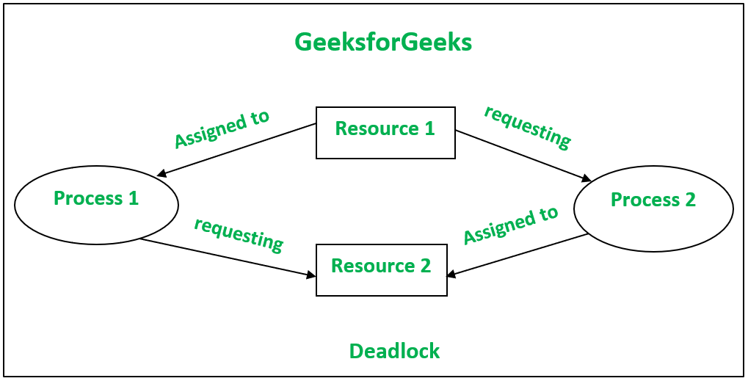
INTRODUCTION
Deadlock in operating system is a situation which occurs when a process or thread enters a waiting state because a resource requested is being held by another waiting process, which in turn is waiting for another resource held by another waiting process.
In a deadlock state a process is unable to change its state(waiting) indefinitely because the resources requested by it are being used by another waiting process.

Slide 5
PROBLEM STATEMENT
Creating the deadlock and prevent the deadlock by using the bankers
Algorithm and also compare both deadlock and non deadlock state.

Slide 6
SCOPE OF THE PROJECT
The scope of the project is to identify the conditions for deadlocks, distinguish the different circumstances that lead to this undesirable state, and identify the methods for detection, prevention, and recovery.

Slide 7
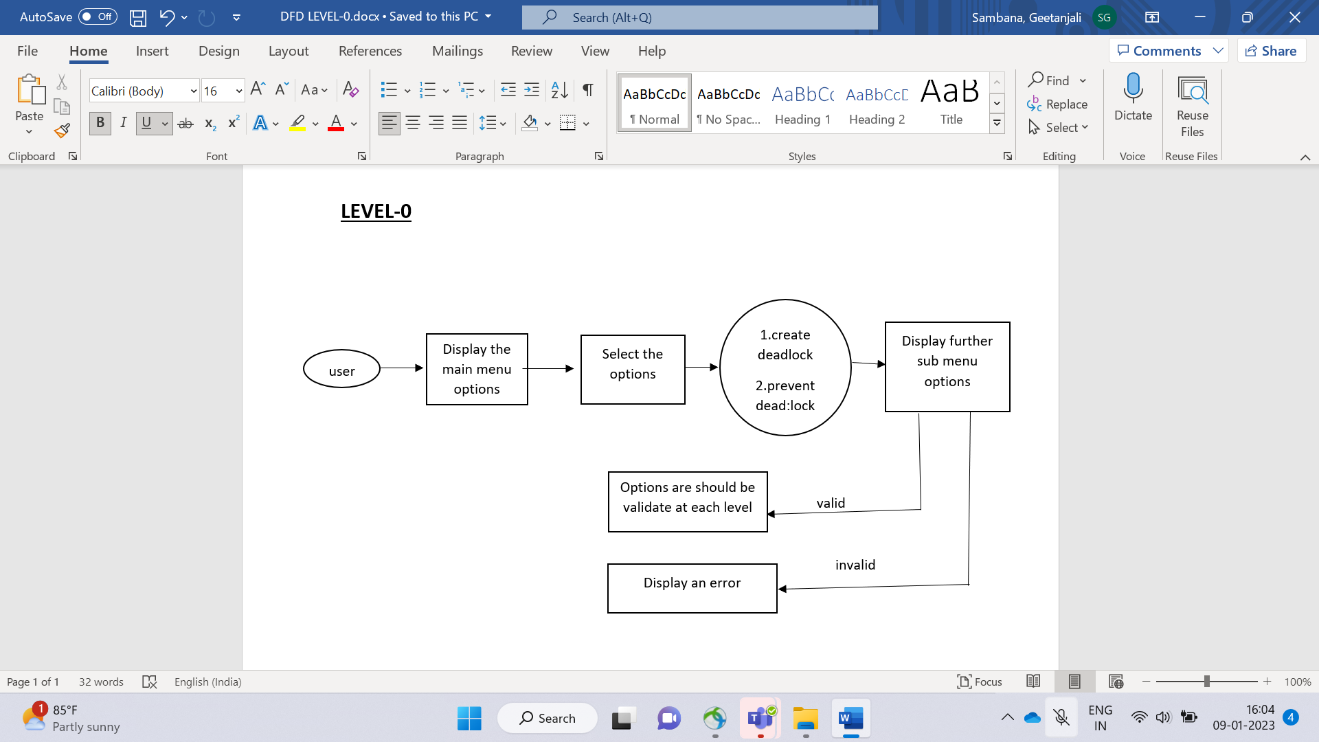
LOW LEVEL DESIGN

Slide 8
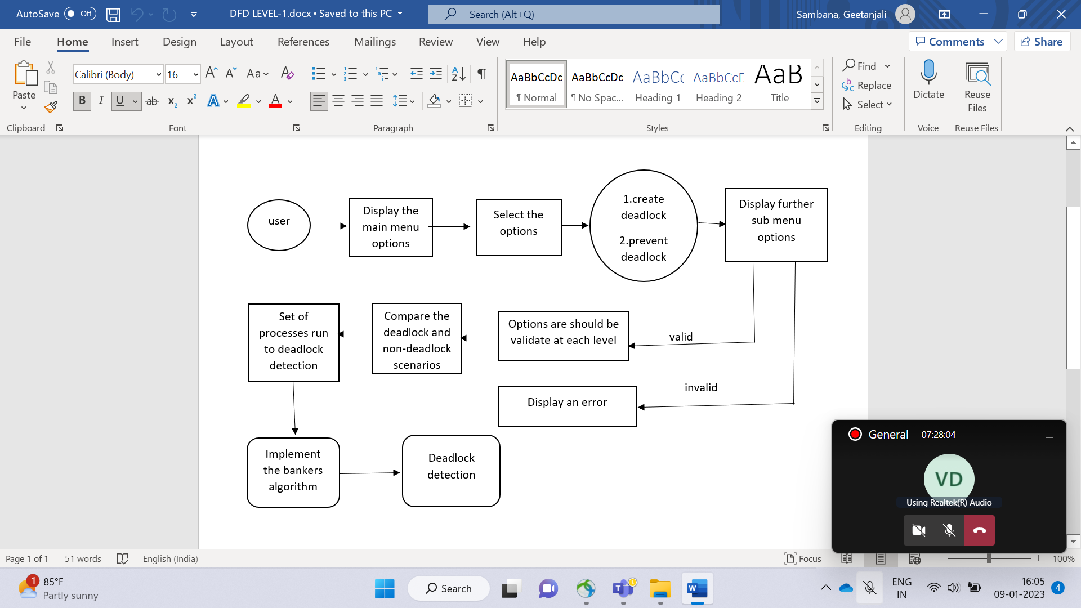
HIGH LEVEL DESIGN

Slide 9
FUNCTIONAL REQUIREMENTS
Functional requirements are the services provided by the system to its end users
Functions()
DeadLock Creation
DeadLock Prevention
DeadLock Avoidance

Slide 10
NON FUNCTIONAL REQUIREMENTS
A non-functional requirements defines the quality attribute of a software system
Valgrind Tool
Make file

Slide 11
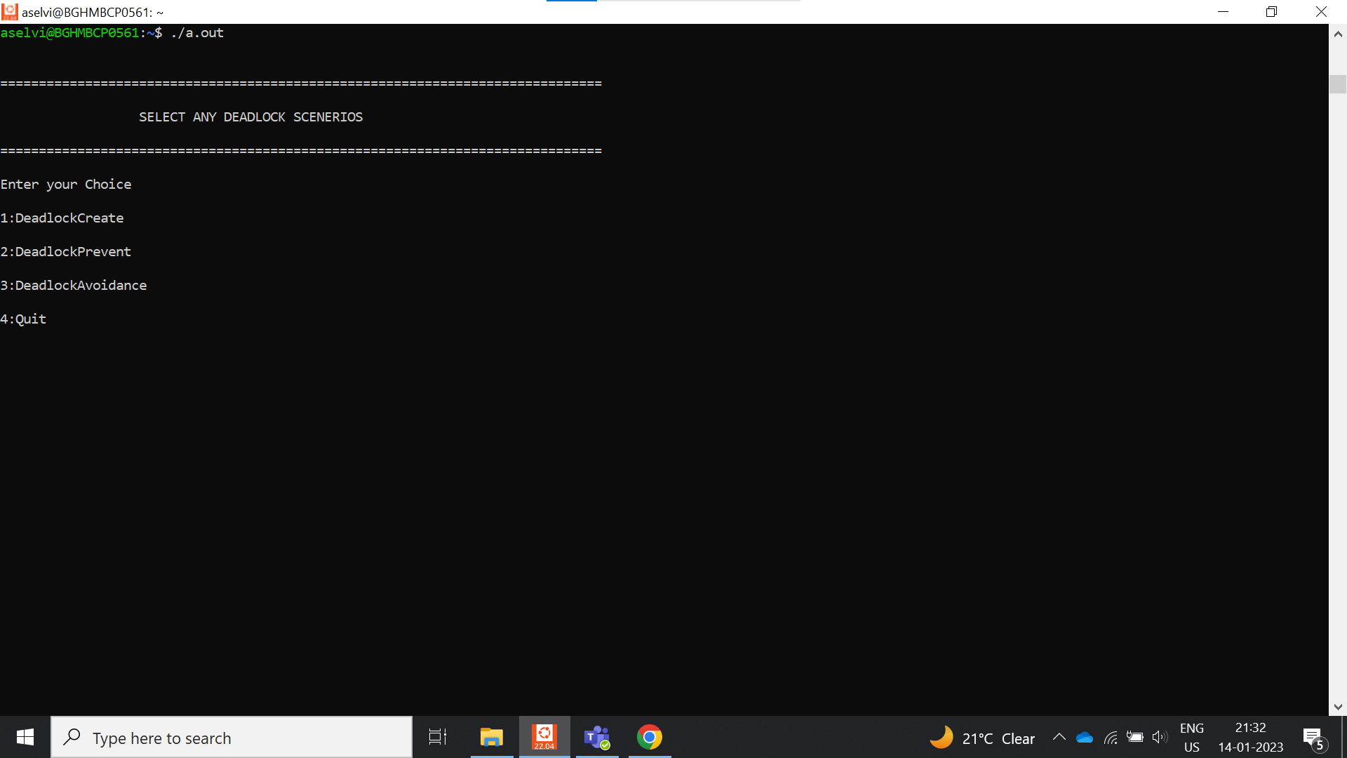
IMPLEMENTATION

Slide 12
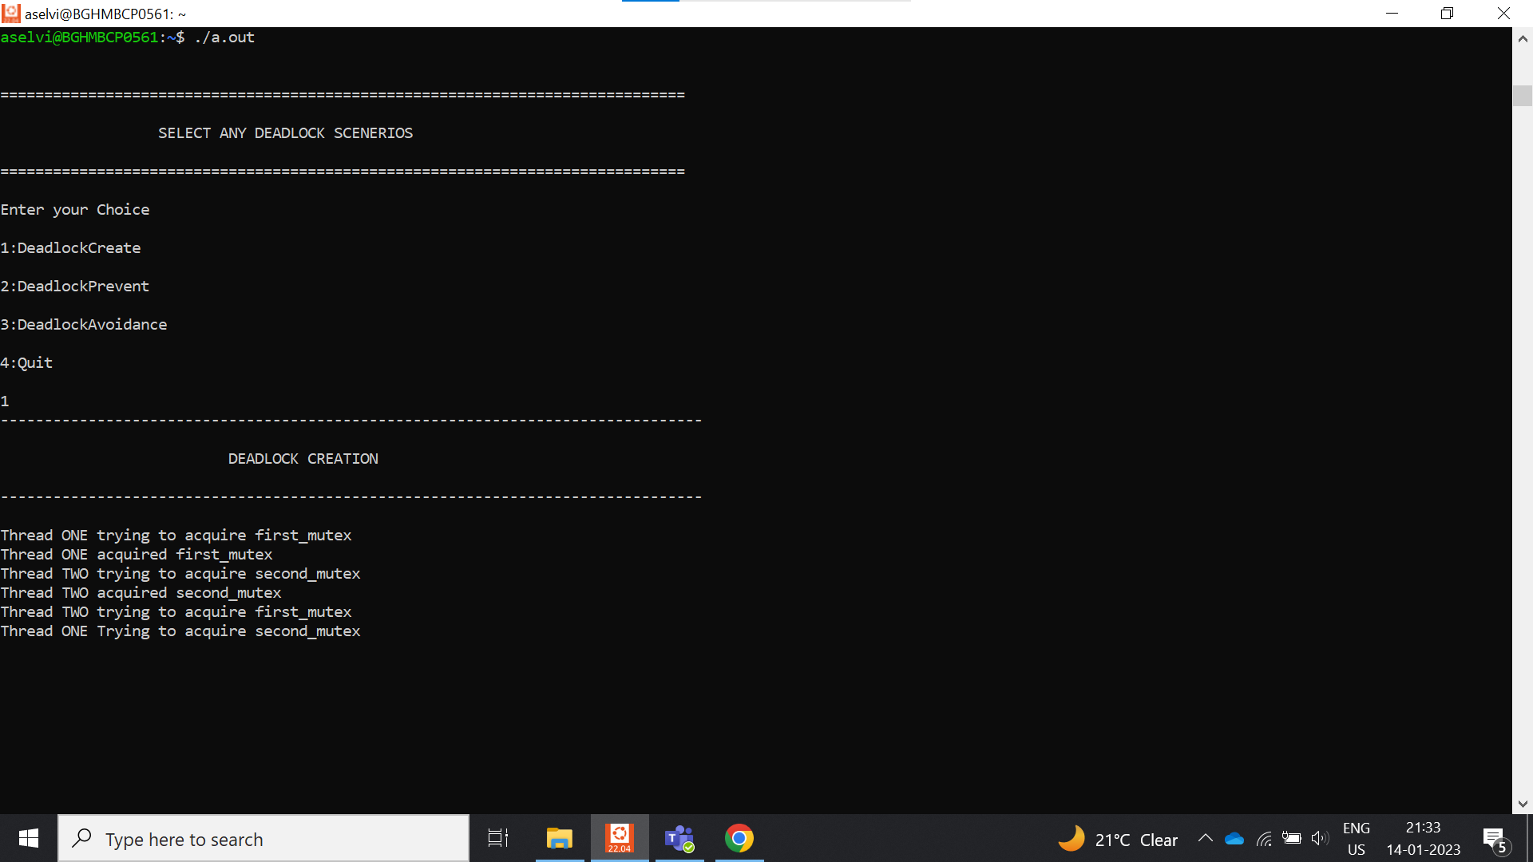
IMPLEMENTATION

Slide 13
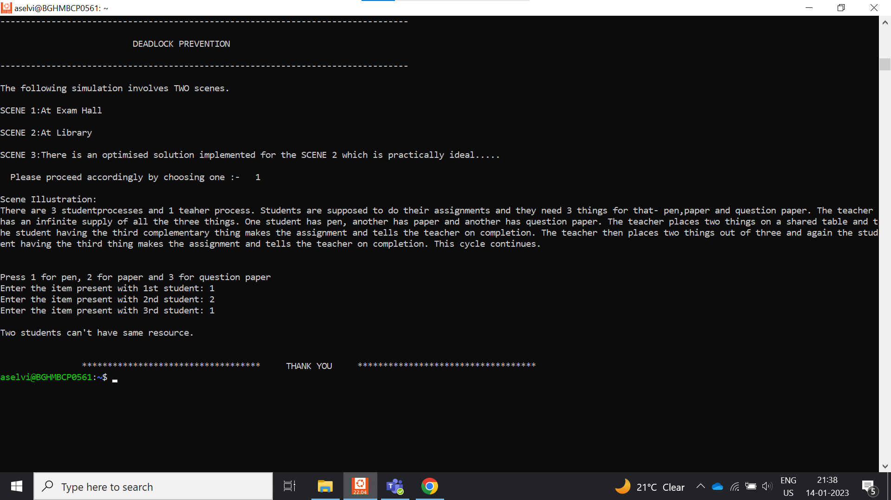
IMPLEMENTATION

Slide 14
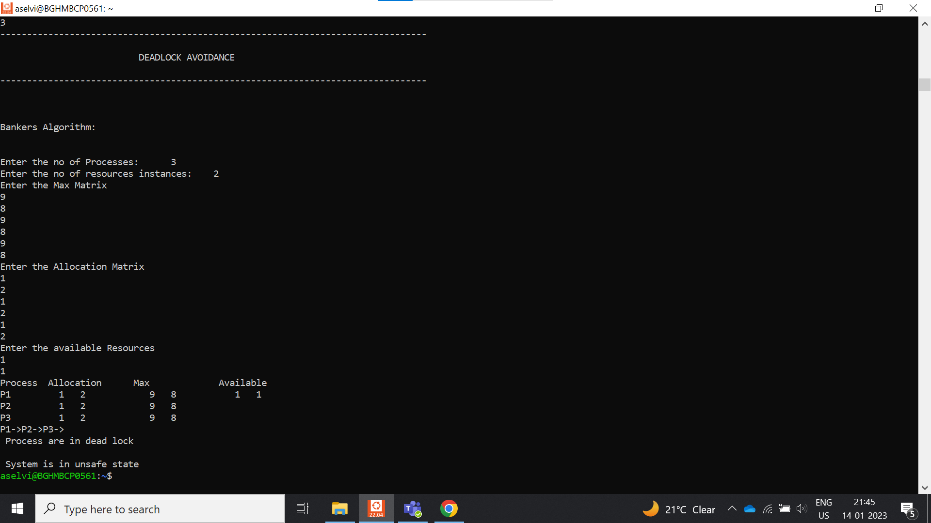
IMPLEMENTATION

Slide 15
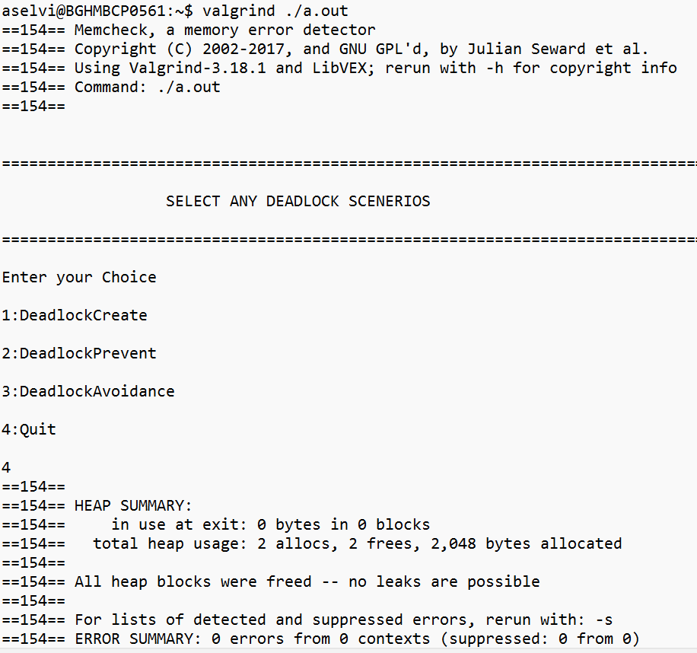
TESTING

Slide 16
CONCLUSION
We can conclude that our project will create, prevent deadlock and also avoid deadlock using the bankers Algorithm.
Future Scope
We are going to implement the remaining conditions like hold and wait, no preemption and circular wait.

Slide 17
THANK YOU

